Slide 1
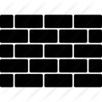
Firewall
Topic discussed and presentation developed by
Jordan R Kharkrang and Prakash Parajuli
MCA 4th Semester
St. Anthony’s College, Shillong

Slide 2

contents
Introduction
History
What is a Firewall ?
Design Goals of a Firewall
Types of Firewall
Application of Firewall
Advantages of firewall
Disadvantages of firewall
Conclusion
References

Slide 3
The internet has made large amount of information
available to the average user at home, in business and
education.
For many people, having access to this information is no
longer just an advantages; it is essential.
Therefore, security of the network is the main criteria
here and firewall provides this security.
Introduction

Slide 4
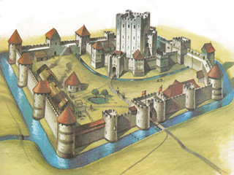
The term firewall originally referred to a wall intended to confine a fire or potential fire within a building.
Firewall technology emerged in the late 1980s.
The predecessors to firewalls for network security were the routers used in the late 1980s.
The first paper published on firewall technology was in 1988,by Jeff Mogul from DEC(PSF).
Morris Worm.
History

Slide 5
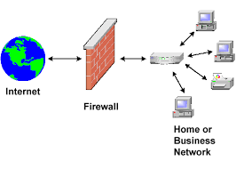
In computing, a firewall is a network security system that monitors and controls the incoming and outgoing Network traffic based on predetermined
security rules.
A firewall typically establishes a barrier between a trusted, secure internal network and another outside
network, such as the Internet, that is assumed not
to be secure or trusted.
What is a
Firewall ?

Slide 6
A firewall is that collective sum of all network traffic from
the internal to external must go through the firewall
physically cutting off all access to the local network
except via the firewall.
Only authorized traffic which is delineated by the local
security policy will be allowed to proceed.
The firewall itself is resistant to penetration inclusive is
trustworthy system with a protected operating system.
Design Goals
of a
Firewall

Slide 7
Firewalls are generally categorized as network-based
or host-based.
Network-based firewalls
Host-based firewalls
Firewalls also vary in type depending on where
communication originates, where it is intercepted,
and the state of communication being traced.
Packet filtering firewall
Application firewall
Circuit-Level Gateway
Types of
Firewall

Slide 8
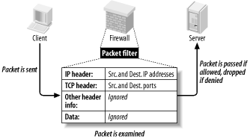
Work on the first three layers of OSI reference model
Packet filtering inspects each packet passing through the
network and accepts or rejects it based on user-defined
rules.
Two default policies: forward or discard.
For example if a rule in the firewall exists to block telnet
access then the firewall will block IP protocol for port
number 23.
Packet filtering firewalls

Slide 9
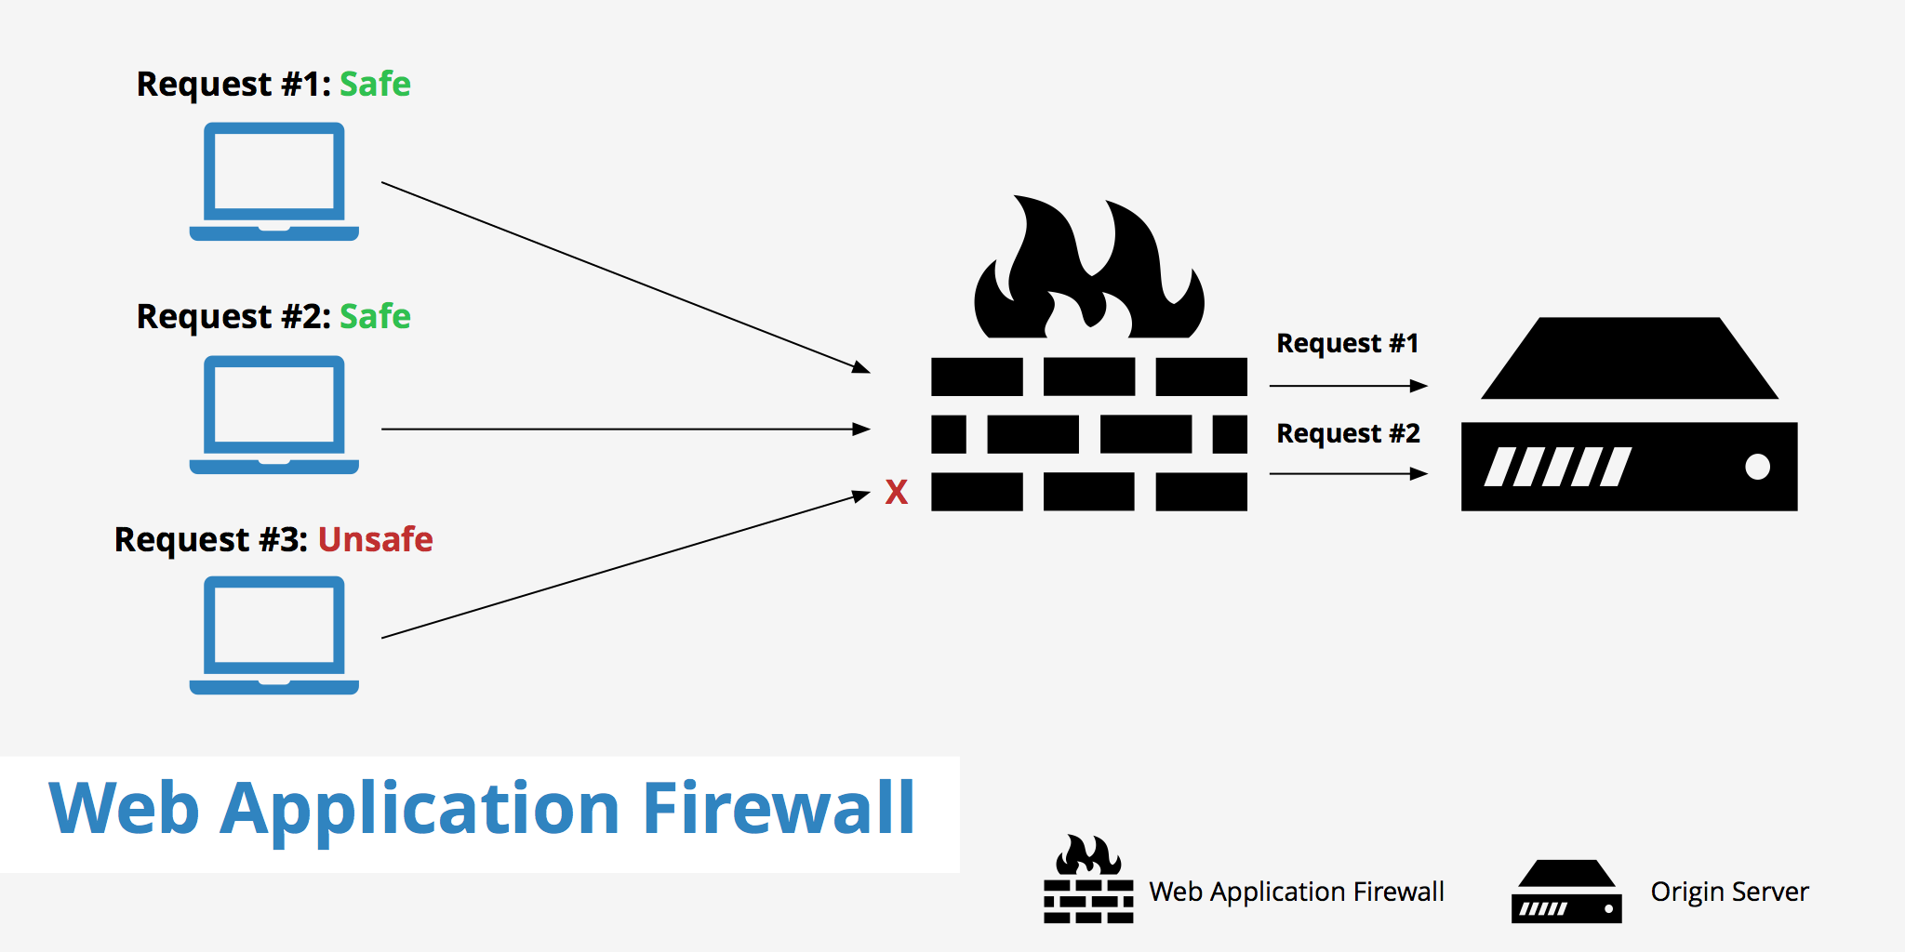
An application firewall is a form of firewall which controls
input, output, and/or access from, to, or by an application
or service.
Application firewall

Slide 10
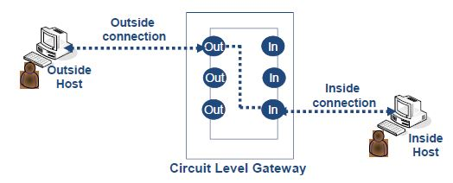
Circuit level gateways work at the session layer of the
OSI model, or as a “shim-layer”between the application
layer and the transport layer of the TCP/IP stack.
Circuit-Level Gateway
Firewall

Slide 11
Traffic monitoring.
Trojans blocking.
Prevents hackers from gaining access to
the system.
Key logging attempts.
Provides statistics on network use.
Advantages
of Firewall

Slide 12
Diminished Performance
Vulnerabilities
Internal Attack
Cost
Disadvantages
of Firewall

Slide 13
One of the best things about firewall from a security
standpoint is that it stops anyone on the outside from
logging onto a computer in your private network.
While this is a big deal for business, most home network
will not probably not be threatened in this manner. Still,
putting a firewall in place provides some peace of mind.
Conclusion

Slide 14
Web source:
http://www.ebrahma.com/2015/04/firewall-basic-concepts/
https://www.slideshare.net/anthonydaniel14/network-firewall
-function-benefits
Book source:
Cryptography and Network Security 4th edition by W. Stalling
-Page no -622
References

Slide 15
Thank you ☺

Slide 16
Back up slides

Slide 17
Source
Destination
Service
Action
Basic
concept

Slide 18
It act as a barrier between the network of machine
the user that operates it under a common security
policy.
Two reason to use firewall :
-to save money.
-simple architecture.
Role of a
Firewall

Slide 19
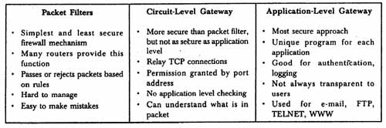
comparison

